Slide 1







Developer Survey 2019 from Stack Overflow Salient Findings
AKSHAT SOLANKI
September 2022

Slide 2



OUTLINE
Executive Summary
Introduction
Methodology
Results
Visualization – Charts
Dashboard
Discussion
Findings & Implications
Conclusion
Appendix

Slide 3

EXECUTIVE SUMMARY
The important conclusions from an examination of the data gathered as part of the 2019 Stack Overflow Developer Survey are summarised in the following slides.
The analysis provided information on the following:
The most widely used databases, languages, and other technologies (at the time of data collection)
Beliefs about the technologies that will be most in demand in the future
Demographic Statistics (e.g., the gender gap among developers)
These results are especially important for current and aspiring Educators, policymakers, developers, and recruiters.

Slide 4

INTRODUCTION
Stack Overflow, an online community for exchanging programming skills, has hosted the Stack Overflow Annual Developer Survey.
The annual surveys' main goal is to compile information on technology usage and trends among developers.
A portion of the 2019 dataset (current dataset: N = 11,398; original dataset: N 90,000) was examined in this analysis.
Audience: Policymakers, educators, professionals in HR, and current and aspiring developers

Slide 5

METHODOLOGY
2019 Stack Overflow Developer Survey, data source:
Stack Overflow’s annual survey data and results (https://rb.gy/4mfa5j)
Data Wrangling: A subset of the dataset (supplied by IBM) was loaded and cleaned using SQL and Python’s pandas module.
Steps:
Removing Duplicates
Imputing Data
Normalizing Data
Data-set provided by IBM (https://rb.gy/cahwoo)
Analysis & Visualization: IBM Cognos and various Python libraries were used for EDA and data visualization. The following metrics were specifically looked at:
Technologies used in 2019 (i.e., languages, databases, platforms, and web frames)
The most desired technologies for the upcoming year
Statistics (i.e., gender, country, age, and education)

Slide 6
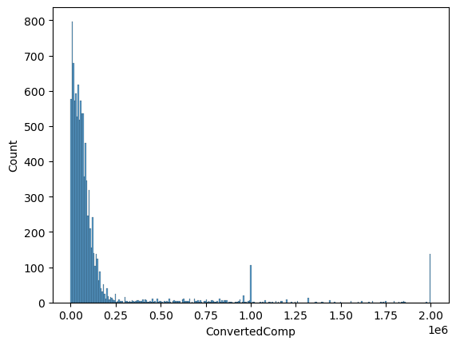
RESULTS
Descriptive statistics regarding demographics and total annual compensation were generated
Sample size after removing compensatory outliers: N = 10,519 (vs. N = 11,398 before removal)
The respondents' median age was 29, and 93.5% of them were men compared to 6.5% of women
Median compensation was found to be $52,704 USD per year
Compensation and Age were positively correlated with r = .40
Women received a higher median salary ($54,956) than men ($52,339)

Slide 7
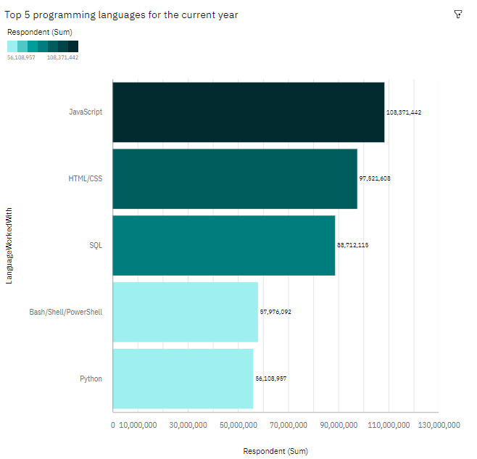
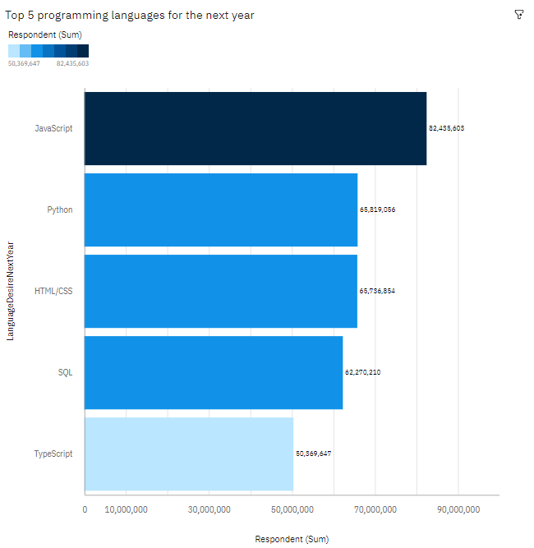
PROGRAMMING LANGUAGE TRENDS
Current Year
Next Year

Slide 8
PROGRAMMING LANGUAGE TRENDS - FINDINGS & IMPLICATIONS
Findings
The most popular languages in 2019 were JavaScript and HTML/CSS, and they will probably continue to be so in 2020.
SQL was well-liked in 2019 and probably will be in 2020.
Python and TypeScript are becoming more popular.
Declining enthusiasm for Bash, Shell, and PowerShell.
Implications
JavaScript and HTML/CSS continue to be the most popular languages for web development, however TypeScript might swiftly catch-up with them in the future.
SQL is still the go-to language for storing and querying big-data, and it isn't going anywhere anytime soon.
Python's increased popularity is most likely a result of the expansion of AI and ML research.

Slide 9
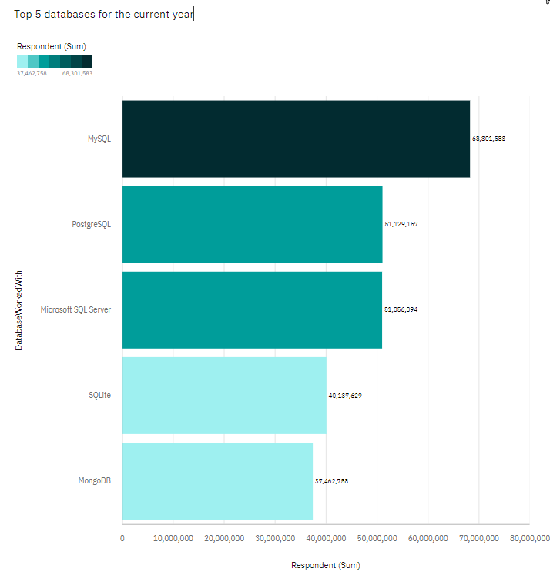
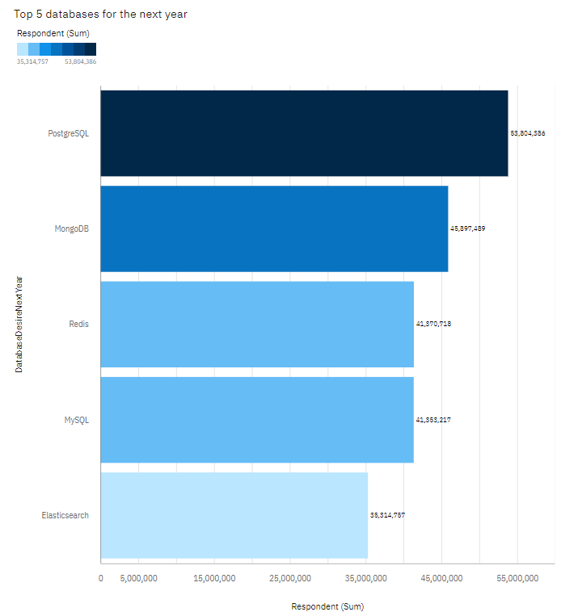
DATABASE TRENDS
Current Year
Next Year
< Bar chart of top 5 databases for the current year goes here >
< Bar chart of top 5 databases for the next year goes here.>

Slide 10
DATABASE TRENDS - FINDINGS & IMPLICATIONS
Findings
The most widely used SQL database programmes in 2019 were MySQL.
In comparison to other SQL database applications, PostgreSQL is growing in popularity and was voted as the most wanted database for the upcoming year.
2019 saw an increase in popularity and interest for MongoDB.
Elasticsearch is attracting more attention.
Implications
Developer preference for open-source database programmes looks to be rising.
The popularity of NoSQL database programmes is probably due to the increased necessity to manage non-relational and unstructured data.
Data analysts should become proficient in NoSQL as well as SQL database management systems.

Slide 11

DASHBOARD
Following link contains the IBM Cognos dashboard prepared with 3 tabs (a) current technology usage, (b) future technology trend, and (c) demographics of the survey respondents:
https://rb.gy/9k23ld
Cognos link (https://rb.gy/ko4ksn)

Slide 12
DASHBOARD TAB 1

Slide 13
DASHBOARD TAB 2
Screenshot of dashboard tab 2 goes here

Slide 14
DASHBOARD TAB 3
Screenshot of dashboard tab 3 goes here

Slide 15
DISCUSSION
In light of the facts as a whole, it is possible to answer the following questions:
Which developer technologies are most in demand?
Which technologies ought aspiring programmers and data specialists should be learning?
Which educational technology should educators focus on more in the next years?
How is the annual distribution of developer remuneration structured?
Who makes up the developer population? Is there a disparity in gender representation?

Slide 16
OVERALL FINDINGS & IMPLICATIONS
Findings
HTML/CSS and JavaScript continue to see high usage and attention. Typescript is becoming more popular as well.
Growing enthusiasm for Python.
High interest and utilisation of SQL. Although PostgreSQL is gaining popularity and was the overall most requested database programme for the following year, MySQL had the most usage in 2019.
NoSQL database software is becoming more popular, with MongoDB being the most popular in 2019 and sought for 2020.
A significant gender pay disparity (in favour of men), despite women receiving slightly higher median salaries.
Differences in technology between nations.
Implications
Demand for web development is still very high. In addition to JavaScript, HTML/CSS, and Typescript, developers may want to learn Typescript.
Data workers should continue to improve their SQL skills but should also improve their proficiency with NoSQL database tools and Python due to the increased demand to handle huge data and undertake AI and ML work.
Businesses must adjust to customers' shifting technology choices, particularly in terms of hiring and developing new talent.
Along with the technological difference between nations, policymakers, schools, and organisations should aim to reduce the gender representation gap.

Slide 17

CONCLUSION
We analysed at a portion of the data gathered for the 2019 Stack Overflow Developer Survey.
The results provided several insights into the developer population as well as the technologies that developers most frequently utilised and requested.
These observations should be especially helpful to existing and aspiring developers who want to stay competitive, businesses who want to upskill their workforce, industry instructors, and policymakers who want to address gender and economic challenges.

Slide 18

APPENDIX
Include any relevant additional charts, or tables that you may have created during the analysis phase.

Slide 19
APPENDIX: JOB POSTINGS

Slide 20
APPENDIX: POPULAR LANGUAGES

